Slide 1
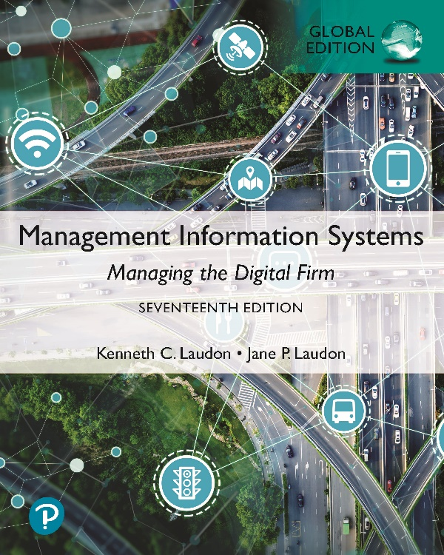
Management Information Systems: Managing the Digital Firm
Seventeenth Edition, Global Edition
Chapter 5
I T Infrastructure and Emerging Technologies
Slide in this Presentation Contain Hyperlinks. JAWS users should be able to get a list of links by using INSERT+F7
Copyright © 2022, 2020, 2018 Pearson Education, Ltd. All Rights Reserved
Notes:
If this PowerPoint presentation contains mathematical equations, you may need to check that your computer has the following installed:
1) MathType Plugin
2) Math Player (free versions available)
3) NVDA Reader (free versions available)

Slide 2
Learning Objectives
5.1 What is I T infrastructure, and what are the stages and drivers of I T infrastructure evolution?
5.2 What are the components of I T infrastructure?
5.3 What are the current trends in computer hardware platforms?
5.4 What are the current computer software platforms and trends?
5.5 What are the challenges of managing I T infrastructure and management solutions?
5.6 How will M I S help my career?
Notes:
Are students familiar with any of the trends in hardware or software platforms? Do they see the iPhone/iPad, for instance, as a device, a computing platform, or a just a telephone? They might be familiar with developments such as Facebook Platform, a set of services, tools, and products that enable developers to design games and activities for use within Facebook itself. Also recall that cloud computing has been mentioned in earlier chapters, so students should be able to point to that as a contemporary hardware platform trend.

Slide 3
Video Cases
Case 1: Rockwell Automation Fuels the Oil and Gas Industry with the Internet of Things (I o T)
Case 2: ESPN.com: The Future of Sports Broadcasting in the Cloud
Case 3: Netflix: Building a Business in the Cloud

Slide 4
Grab Leverages Information Technology to Enhance Its Services
Problem
  providing customers with timely service and drivers with enough fares
  matching demand with resources in an unpredictable sector
Solutions
  Managed cloud infrastructure
  On-demand, scalable services
Illustrates use of cloud computing to improve effectiveness and control costs

Slide 5
Defining I T Infrastructure
Set of physical devices and software required to operate an enterprise
Set of firm-wide services including:
  Computing platforms providing computing services
  Physical facilities management services
  I T management, education, and other services
“Service platform” perspective
  More accurate view of value of investments
Notes:
The “service platform” perspective refers to analyzing the actual services enabled by new technology tools. For example, a new PC or tablet might save an employee one hour per day in wait time for information, dramatically increasing his or her value to the firm.

Slide 6
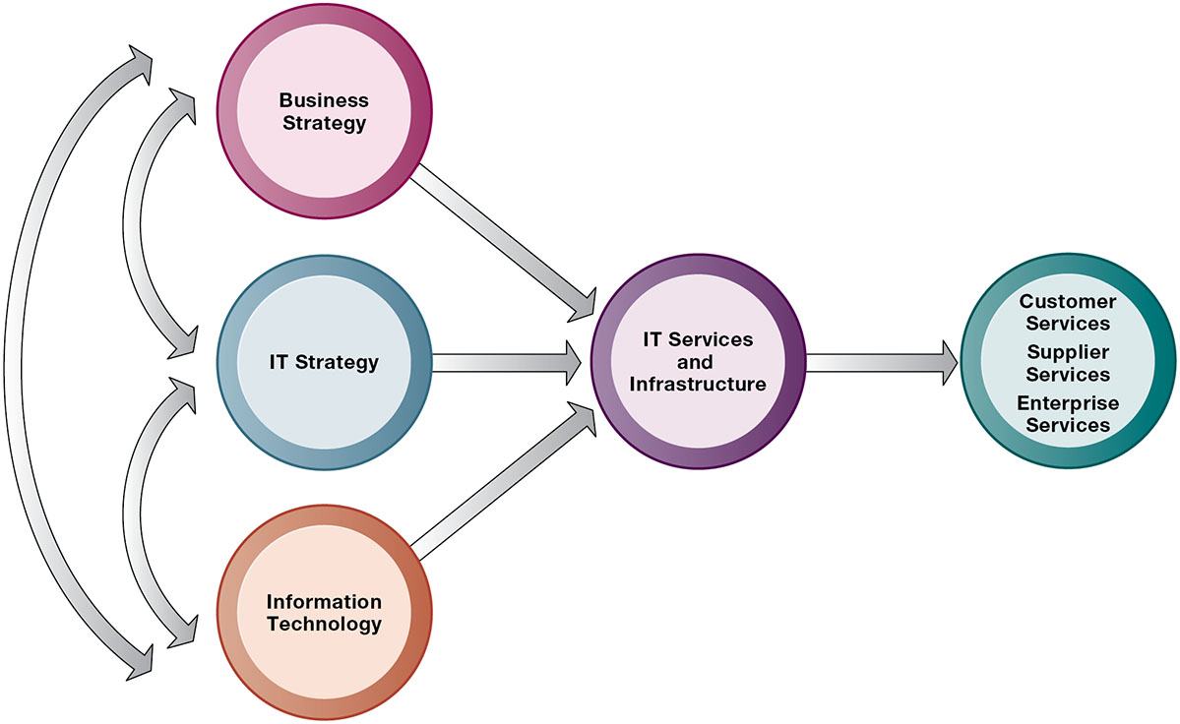
Figure 5.1 Connection Between the Firm, I T Infrastructure, and Business Capabilities
Notes:
Figure 5.1, Page 166.
The services a firm is capable of providing to its customers, suppliers, and employees are a direct function of its IT infrastructure. Ideally, this infrastructure should support the firm’s business and information systems strategy. New information technologies have a powerful impact on business and IT strategies as well as the services that can be provided to customers.
The point of this slide is to illustrate the centrality of IT infrastructure and services to the achievement of firm success. Ultimately, what the firm delivers to customers, its quality, is a direct function of the power of its infrastructure. For instance, Amazon is routinely cited as the most popular online shopping site and receives high praise from customers for the quality of its service and speed of execution. There is a reason for this: Amazon has one of the world’s largest and well-designed computing infrastructures to provide these services.
Alt Text
Long description: A path diagram illustrates how the firm, IT infrastructure, and business capabilities are connected. Details of the connections are as follows:
A one-way path is shown between business strategy, IT strategy, and Information technology are connected to the IT services and infrastructure.
The IT services and infrastructure is connected to: Customer, supplier, and enterprise services.
An independent connection is shown between the following:
Business strategy and IT strategy
IT strategy and information technology
Information technology and business strategy

Slide 7
Evolution of I T Infrastructure
General-purpose mainframe and minicomputer era: 1959 to present
Personal computer era: 1981 to present
Client/server era: 1983 to present
Enterprise computing era: 1992 to present
Cloud and mobile computing: 2000 to present
Notes:
Students may be unfamiliar with the concept of mainframe computers. Explain the difference in size (much larger) and computing capacity (much smaller in early decades of mainframes) from today’s computers to give them a sense of perspective regarding how far the computing industry has gone in 60 years. However, modern-day mainframes (IBM z-Series), are extremely powerful servers used for large Fortune 1000 enterprise networks and corporate websites. The mainframe is not dead, in other words, and still represents a large revenue stream for IBM.
Examples of the use of cloud computing are G Suite, Google’s suite of software applications that rivals Microsoft’s Office applications at a fraction of the cost, and Salesforce.com’s CRM management software, delivered over the Internet. Most large Fortune 500 firms have some applications that run in the cloud. Most of these same corporations do not put their strategic or critical systems in the cloud just yet because of lingering concerns about reliability and security.

Slide 8
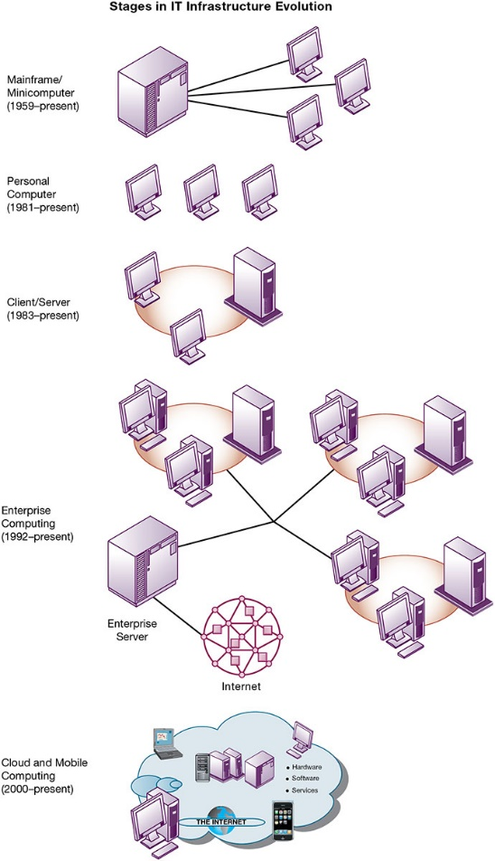
Figure 5.2 Stages in I T Infrastructure Evolution
Notes:
Figure 5.2, Page 168.
Illustrated here are the typical computing configurations characterizing each of the five eras of IT infrastructure evolution.
This slide shows the portion of Figure 5.2 that illustrates the eras of IT infrastructure evolution discussed in the previous slide. Explain so students understand that the yellow ring connecting the machines in the client-server graphic represents a local area network. Personal computers were stand-alone systems prior to the development of local area networks.
Alt Text
Long description: A network diagram illustrates the various stages in the evolution of IT infrastructure. The stages are as follows:
Mainframe or Minicomputer from 1959 to present: Depicted by a connection between a server and various desktop computers.
Personal Computer from 1981 to present: Depicted by several desktop computers.
Client Server from 1983 to present: Depicted by a server connected to desktop computers in a circular manner.
Enterprise computing from 1992 to present: Depicted by network of various servers connected to several desktop computers with CPU in a circular manner to one enterprise server. The enterprise server is connected to the internet.
Cloud and mobile computing from 2000 to present: Depicted by the internet virtually connected to various devices such as: Desktop computer with CPU, laptop, another desktop which represents hardware, software, and services along with a smart phone in a cloud. In the center of the cloud are several servers, including the enterprise server.

Slide 9
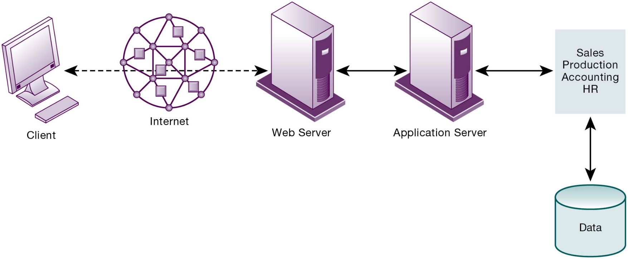
Figure 5.3 A Multitiered (N-Tier) Client/Server Network
Notes:
Figure 5.3, Page 170.
In a multitiered client/server network, client requests for service are handled by different levels of servers.
Explain that the distribution of computing power across smaller, less expensive machines enabled by client/server computing is in part responsible for the drastic increase in computing power and applications throughout the firm. Prior to small, less expensive server computers, computing power had to purchased in large blocks at great expense. With client/server computing, you can grow your firm’s inventory of computers gradually, over time, to meet current demand.
Alt Text
Long description: A sequential flow diagram explains the client server network. The details of the network are as follows:
Data
Sales, production, accounting, and HR
Application server
Web server
Internet
Client
All these aspects of the network are connected by solid bi-directional arrows except for the connection between the web server, internet, and the client. The same is denoted by dashed bi-directional arrows.

Slide 10
Technology Drivers of Infrastructure Evolution (1 of 2)
Moore’s law and microprocessing power
  Computing power doubles every 2 years
  Nanotechnology
Law of Mass Digital Storage
  The amount of data being stored each year doubles
Metcalfe’s Law and network economics
  Value or power of a network grows exponentially as a function of the number of network members
Notes:
Variants of Moore’s Law include: the number of transistors on a chip doubles ever 18 months; computing power doubles every 18 months; and the price of computing falls by half every 18 months. Explain to students that even now, this trend continues but has slowed to around 2 years, with transistors today about 14 nanomenters (billionths of a meter) in size.
Ask students to explain the implications of Metcalfe’s law to social networks, such as Facebook and Twitter. Do they agree that the more members are using the site, the value of being a member and the usefulness of the site grows? Do people make “new friends” on a social site or hang out with their existing friends mostly? Aare “friends” the same as “followers”?

Slide 11
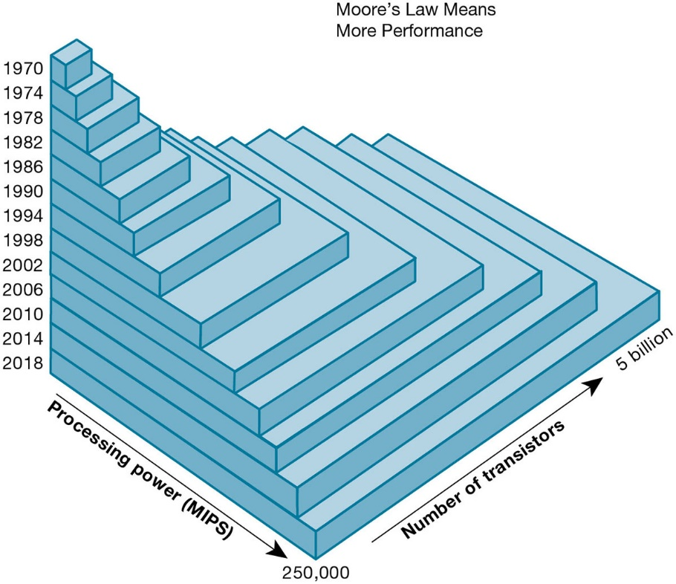
Figure 5.4 Moore’s Law and Microprocessor Performance
Notes:
Figure 5.4, Page 172.
Packing more than 5 billion transistors into a tiny microprocessor has exponentially increased processing power. Processing power has increased to more than 250,000 MIPS (about 2.6 billion instructions per second).
At what point, if any, do students believe that the doubling trend of Moore’s Law might come to an end? Ask them to speculate and give reasons for their answers.
Alt Text
Long description: A three-dimensional bar graph explains the correlation between the number of transistors and millions of instructions per second over the years. The details of the graph are as follows:
The vertical axis represents the years and ranges from 1970 to 1974, in increments of 4.
The first horizontal axis represents the processing power in millions of instructions per second and ranges from 0 to 250,000.
The second horizontal axis represents the number of transistors and ranges from 0 to 5 billion.
It explains that the number of transistors, and therefore its processing power shows an increasing trend over the years.

Slide 12
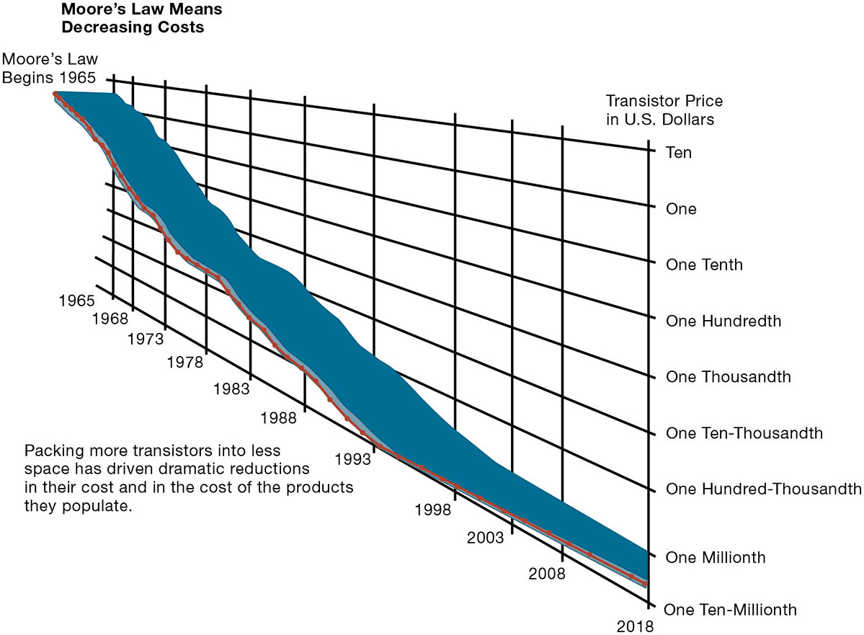
Figure 5.5 Falling Cost of Chips
Notes:
Figure 5.5, Page 172.
Packing more transistors into less space has driven dramatic reductions in their cost and in the cost of the products they populate.
What do students think the implications of such drastically reduced costs of computer chips might be in the future? Explain the connection to concepts such as the digital divide and cloud computing.
Alt Text
Long description: A line graph illustrates the declining trend in the cost of chips over the years. The horizontal axis represents the years and ranges from 1965 to 2020 in increments of 5 except between 1965 and 1968. The vertical axis represents the transistor price in U.S. dollars and ranges from ten to one ten millionth in intervals listed below:
Ten
One
One Tenth
One Hundredth
One Thousandth
One Ten-Thousandth
One Hundred-Thousandth
One Millionth
One Ten-Millionth.
The curve appears to be sloping downward and shows a drastic plunge in the trend. Between 1965 and 1993 the price reduced to one millionth and thereafter the price further drops to One Ten-Millionth.
Text in the graph reads: Packing more transistors into less space has driven dramatic reductions in their cost and in the cost of the products they populate.

Slide 13
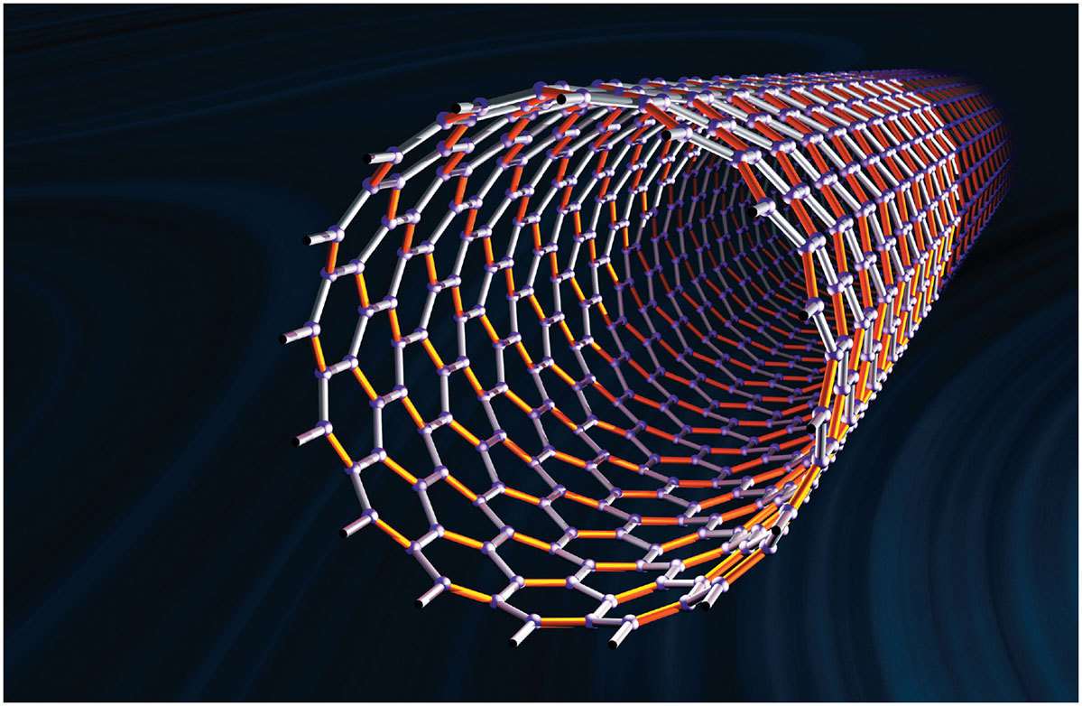
Nanotubes
Notes:
Figure, Page 173.
Nanotubes are tiny tubes about 10,000 times thinner than a human hair. They consist of rolled-up sheets of carbon hexagons and have potential use as minuscule wires or in ultra-small electronic devices and are very powerful conductors of electrical current.
Nanotechnology is used to create transistors of the tiny size previously mentioned. Can students describe any other applications of this type of technology (for example, medical)?

Slide 14
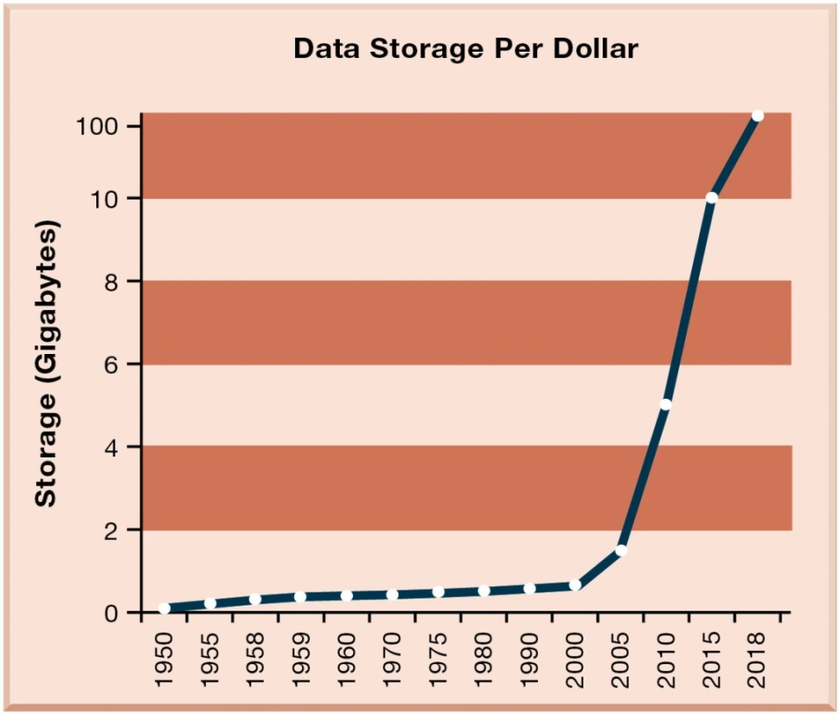
Figure 5.6 The Amount of Storage Per Dollar Rises Exponentially, 1950–2016
Notes:
Figure 5.6, Page 174.
Cloud storage services like Google Drive provide 100 gigabytes of storage for $1.99 per month.
Explain the importance of the exponential growth in hard drive capacity, which is that the world is producing an increasing amount of digital information requiring storage each year as well. Fortunately, the cost of storing that information is decreasing at an even quicker rate. Explain that this figure displays the number of kilobytes of data that can be stored with one dollar. Point out that the Y-axis is greatly compressed to display the doubling effect, and that if it weren’t, the increase from year to year would become increasingly enormous.
Alt Text
Long description: A line graph explains how the cost of data storage has increased over the years. The horizontal axis represents the years and ranges from 1950 to 2020 in irregular intervals. The vertical axis represents the storage in gigabytes and ranges from 0 to 100, in intervals of 2 except between 10 and 100.
Approximate data corresponding to the years and the storage are summarized below:
1952: 0.3; 1957: 1.2; 1962: 2.4; 1966: 3.0; 1971: 3.1; 1976: 3.1; 1981: 3.7; 1985: 3.8; 1990: 4.7; 1995: 5.3; 2000: 12.6; 2004: 43.2; 2009: 87.3; 2013: 103.8.

Slide 15
Technology Drivers of Infrastructure Evolution (2 of 2)
Declining communication costs and the Internet
  Exponential growth in size of the Internet
Standards and network effects
  Technology standards
    Specifications that establish the compatibility of products and the ability to communicate in a network
    Unleash powerful economies of scale and result in price declines
Notes:
Are students aware of any friends or family that do not have Internet access or choose not to have access? You might ask students to guess how fast (slow) were the telephone modems used by most Internet users in 1990s. Fifty-six kbps was the fastest telephone modem which is about 1/20th of a megabit per second. Most cable Internet to the home today is running at 50 mbps, nearly a thousand times faster than telephone modems; 892 to be exact. What might today’s enterprise infrastructure and Internet have been like without widespread and universal standards, such as Windows, Microsoft Office, Unix, and Ethernet? (Greatly decreased efficiency and confusion, inability to develop innovative products everyone can use based on a single standard, etc.)

Slide 16
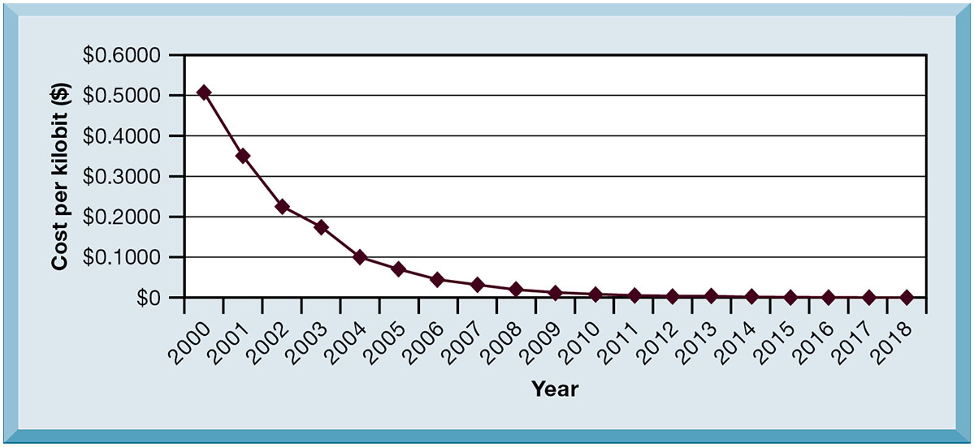
Figure 5.7 Exponential Declines in Internet Communications Costs ($/M B P S)
Notes:
Figure 5.7, Page 175.
The cost of communication over the Internet and over telephone networks has declined exponentially, fueling the explosive growth of communication and computing worldwide.
Emphasize to students how close the communication cost per kilobit has come to an infinitesimal number (nearly 0) since 1995. What implications does this have for the number of people using the Internet? You could once again relate this to the digital divide and emphasize that even now a significant portion of the world lacks access to the Internet and other services, though it has more to do with reasons of insufficient infrastructure than Internet communication costs. One implication: it costs no more to move a gigabyte from New York to San Francisco than it does to move the same amount of information from the top of a building to the basement. This means that data no longer needs to be located “close by” the user.
Alt Text
Long description: A line graph explains how the internet costs have plunged over the years. The horizontal axis represents the years and ranges from 2000 to 2019, in increments of 1. The vertical axis represents the cost per kilobit in dollars and ranges from 0 to 6000, in increments of 1000.
Approximate data corresponding to the years and cost are summarized below:
2000: 5077; 2001: 3478; 2002: 2157; 2004: 970; 2005: 639; 2006: 493; 2007: 380; 2008: 172; 2009: 274; 2010: 315; 2011: 293; 2012: 240; 2013: 157; 2014: 166; 2015: 175; 2016: 153; 2017: 195; 2018: 234; 2019: 244.

Slide 17
What Are the Components of I T Infrastructure?
Computer hardware platforms
Operating system platforms
Enterprise software applications
Data management and storage
Networking/telecommunications platforms
Internet platforms
Consulting system integration services
Notes:
The upcoming slides will go over each component in more detail.

Slide 18
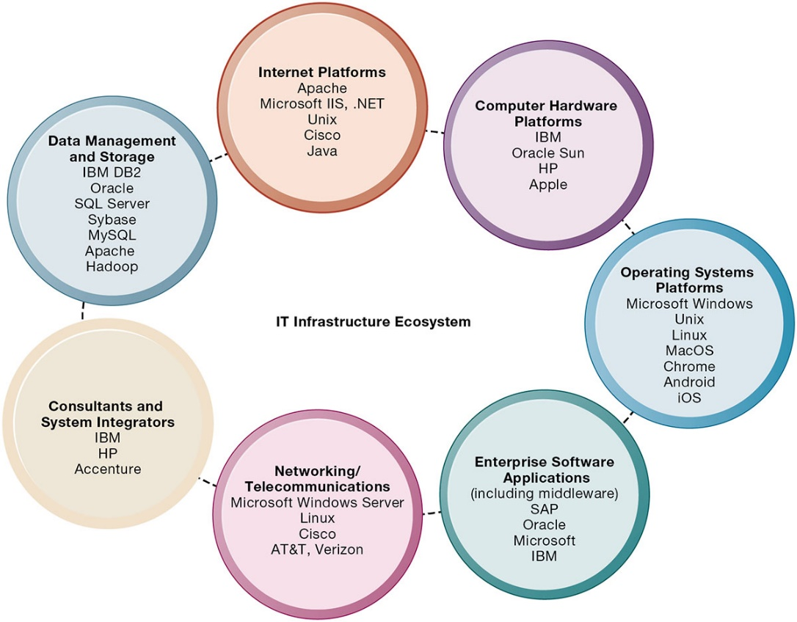
Figure 5.8 The I T Infrastructure Ecosystem
Notes:
Figure 5.8, Page 177.
There are seven major components that must be coordinated to provide the firm with a coherent IT infrastructure. Listed here are major technologies and suppliers for each component.
Ask students to take a look at the example companies that appear under each heading. What companies appear repeatedly? How many items are unfamiliar?
Alt Text
Long description: A circular diagram explains the various components of an IT infrastructure ecosystem. The aspects connected in the ecosystem are: Internet platforms, computer hardware platforms, operating systems platforms, enterprise software applications, networking or telecommunications, consultants and system integrators, and data management and storage.
Internet platforms include: Apache; Microsoft IIS, .NET; Unix; Cisco; Java.
Computer hardware platforms include: IBM; Oracle Sun; HP; Apple.
Operating systems platforms include: Microsoft Windows; Unix; Linux; MacOS; Chrome; Android; iOS.
Enterprise Software Applications (including middleware) include: SAP; Oracle; Microsoft; IBM.
Networking or Telecommunications include: Microsoft Windows Server; Linux; Cisco; AT&T, Verizon.
Consultants and System Integrators include: IBM; HP; Accenture.
Data Management and Storage includes: IBM DB2; Oracle; SQL Server; Sybase; MySQL; Apache; Hadoop.

Slide 19
Computer Hardware Platforms
Client machines
  Desktop P C s, laptops
  Mobile computing: smartphones, tablets
  Desktop chips vs. mobile chips
Servers
Mainframes
  I B M mainframe
  Digital workhorse for banking and telecommunications networks
Notes:
To give students an idea of the size of the market for computer hardware and devices, in 2020, firms worldwide will spend around $900 billion on computer hardware, from mainframes to tablets and smartphones.

Slide 20
Operating System Platforms
Corporate servers
  Windows Server
  Unix
  Linux
Client level
  Microsoft Windows
  Android, i O S, Windows 10 (mobile/multitouch)
  Google’s Chrome O S (cloud computing)
Notes:
Emphasize Microsoft’s traditional dominance in PC operating systems (Windows) and productivity software (Office) and explain that it is the most important reason for their success to date. Currently, Microsoft’s revenues from cloud services and corporate services are their fastest growing segments. Today, the proliferation of operating systems for smartphones and tablet computers (mostly iOS and Android) are mounting a challenge to Microsoft’s dominance which depends heavily on the continued existence of personal computers on corporate local area networks.

Slide 21
Enterprise Software Applications
In 2020, firms are expected to spend over $500 billion on software for enterprise applications
Largest providers: S A P and Oracle
Middleware providers: I B M, Oracle
Notes:
The market for enterprise software applications in 2020 is over $500 billion dollars. These applications are considered to be part of IT infrastructure. Traditionally, large firms were the most prominent users of enterprise software, but firms such as Microsoft have moved into the market of small- and medium-size businesses that can benefit from enterprise software.

Slide 22
Data Management and Storage
Database software providers
  I B M (D B 2)
  Oracle
  Microsoft (S Q L Server)
  SAP Sybase (Adaptive Server Enterprise),
  MyS Q L (Oracle)
  Apache Hadoop
Notes:
Remind students that the amount of new information in the world is doubling every three years, driving the need for more efficient data management and storage.

Slide 23
Networking/Telecommunications Platforms
Network operating systems
  Windows Server, Linux, Unix
Network hardware providers
  Cisco, Juniper Networks
Telecommunication services
  Telecommunications, cable, telephone company charges for voice lines and Internet access
  A T&T, Verizon
Notes:
Companies worldwide are expected to spend $1.5 trillion for telecommunications services in 2020.

Slide 24
Internet Platforms
Hardware, software, management services to support company websites, intranets
  Web-hosting services
  Routers
  Cabling or wireless equipment
Internet hardware server market
  I B M, Dell, Oracle, H P
Web development tools/suites
  Microsoft (Visual Studio and .NET), Oracle-Sun (Java), Adobe
Notes:
The trend since the late 1990s has been to reduce the number of servers by increasing their size and power. Dell, HP/Compaq, and IBM have been the beneficiaries of this trend. Multi-core processors, blade servers, and virtualization are ways in which server power can be radically increased without increasing the physical footprint of data centers although power requirements continue to grow. Web development tools/suites are yet another area where Microsoft is featured prominently. Students at this point should be able to appreciate the sheer size of the company.

Slide 25
Consulting and System Integration Services
Even large firms do not have resources for full range of support for new, complex infrastructure
Leading consulting firms: Accenture, I B M Global Services, H P, Infosys, Wipro Technologies
Software integration: ensuring new infrastructure works with legacy systems
Legacy systems: older T P S created for mainframes that would be too costly to replace or redesign
Notes:
Implementing new infrastructure requires significant changes in business processes and procedures, training and education, and software integration. This is a task that firms struggle to achieve on their own, which drives the need for these services. The MIS course provides students with an excellent background to be a business systems consultant. Most business consulting today involves developing business processes and supporting systems. You might visit a job/career site in class to review the kinds of jobs available to students with IS or MIS majors. In recent surveys MIS majors are among the highest paid college graduates, and after graduation they are the most satisfied group of college graduates because their education led directly to a job!

Slide 26
What Are the Current Trends in Computer Hardware Platforms? (1 of 5)
The mobile digital platform
  Smartphones
  Tablet computers
  Digital e-book readers and apps (Kindle)
  Wearable devices
Consumerization of I T and B Y O D (bring your own device)
  Forces businesses and I T departments to rethink how I T equipment and services are acquired and managed
Notes:
Business computing is increasingly moving from PCs and desktops to mobile devices, and managers are increasingly using these to coordinate work and communicate with employees and customers. Ask students for examples of how they are using smartphones in their business or work.
In the past, IT departments in large firms dictated to their employees what kinds of devices they could use, both on site and off site while traveling. Increasingly, employees are telling the IT department what tools they want to use and demanding that IT support these tools.

Slide 27
Interactive Session: Technology: Open Source Innovation
Class discussion
  How do companies benefit from releasing their proprietary software as open source?
  How do software firms in the East in particular benefit from releasing their source code?
  Select a business and describe how open source innovation can give it a comparative advantage.

Slide 28
What Are the Current Trends in Computer Hardware Platforms? (2 of 5)
Quantum computing
  Uses quantum physics to represent and operate on data
  Dramatic increases in computing speed
Virtualization
  Allows single physical resource to act as multiple resources (i.e., run multiple instances of O S); also enables multiple physical resources (such as storage devices) to appear as a single logical resource (such as in software-defined storage (SDS))
  Reduces hardware and power expenditures
  Facilitates hardware centralization
Notes:
Quantum computing is in its infancy but has the potential to revolutionize computing speeds and power. Virtualization allows organizations to optimize their use of resources in new ways, and also to take advantage of spare computing power by allowing a single resource to act as multiple resources.

Slide 29
What Are the Current Trends in Computer Hardware Platforms? (3 of 5)
Cloud computing
  On-demand computing services obtained over network
    Infrastructure as a service (I a a S)
    Software as a service (S a a S)
    Platform as a service (P a a S)
  Cloud can be public or private
  Allows companies to minimize I T investments
  Drawbacks: Concerns of security, reliability
  Hybrid cloud computing model
Notes:
Explain that on-demand or utility computing describes a payment structure in which cost is dependent upon actual computing power used. Cloud computing refers to online access to hardware, software, and related services that are located and managed remotely. Cloud computing allows organizations to avoid the expenses of maintaining their own hardware and software, relying on the cloud instead. Ask students if they have used Google’s G Suite or other forms of cloud computing, such as like storage services Dropbox, iCloud, Google Drive, or OneDrive. Are there any other concerns they might have over transferring computing resources to a shared “cloud”? Have they read about Amazon Web Services or other cloud services going down and offline for short periods of time?

Slide 30
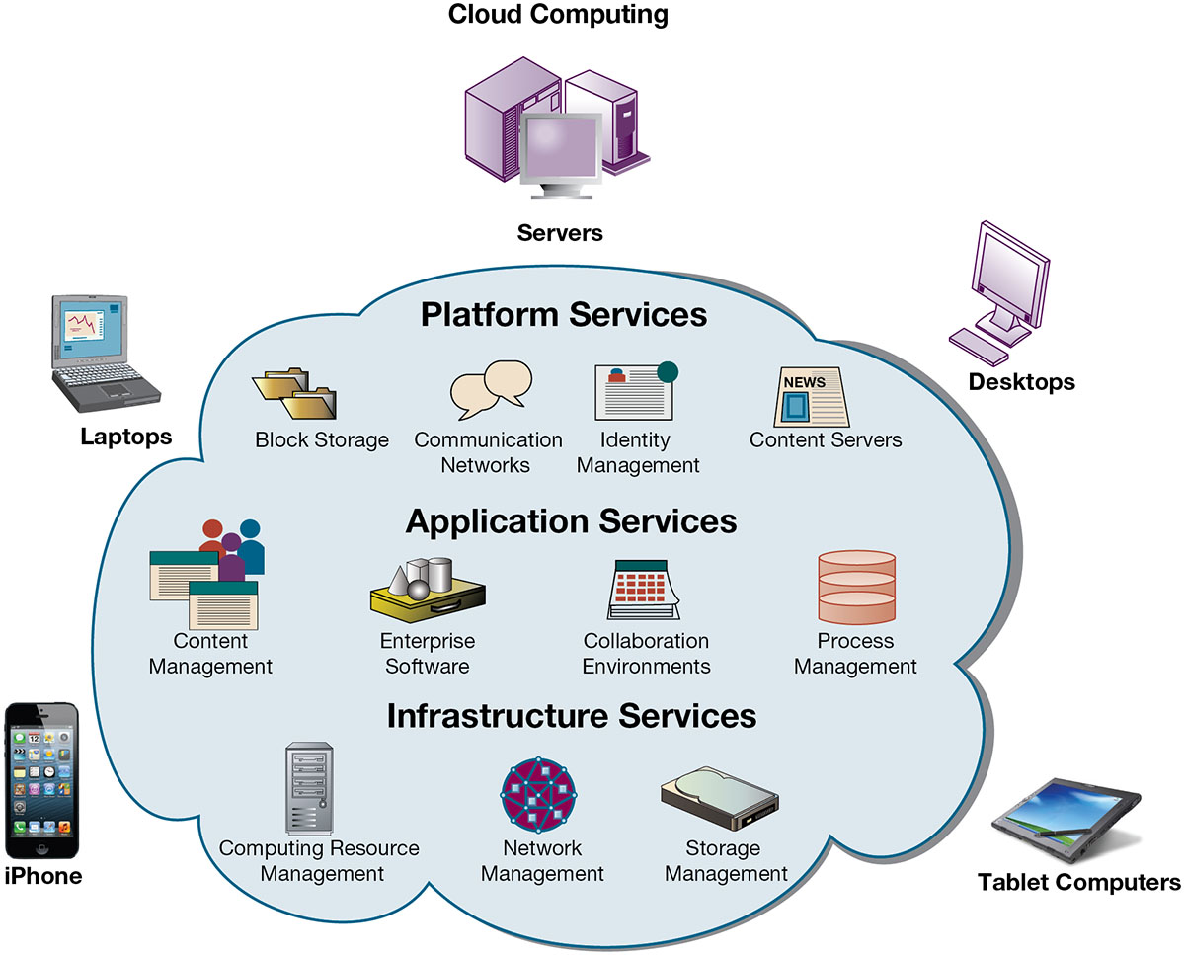
Figure 5.9 Cloud Computing Platform
Notes:
Figure 5.9, Page 184.
In cloud computing, hardware and software capabilities are a pool of virtualized resources provided over a network, often the Internet. Businesses and employees have access to applications and IT infrastructure anywhere, at any time, and on any device.
Alt Text
Long description: An illustration explains the concept of cloud computing. The illustration shows a cloud virtually connected to multiple devices such as: Servers, desktops, tablet computers, smart phones, and laptops via various services.
The details of the services are as below:
Platform services: Block storage, communication networks, identity management, and content services.
Application services: Content management, enterprise software, collaboration environments, and process management.
Infrastructure services: Computing resource management, network management, and storage management.

Slide 31
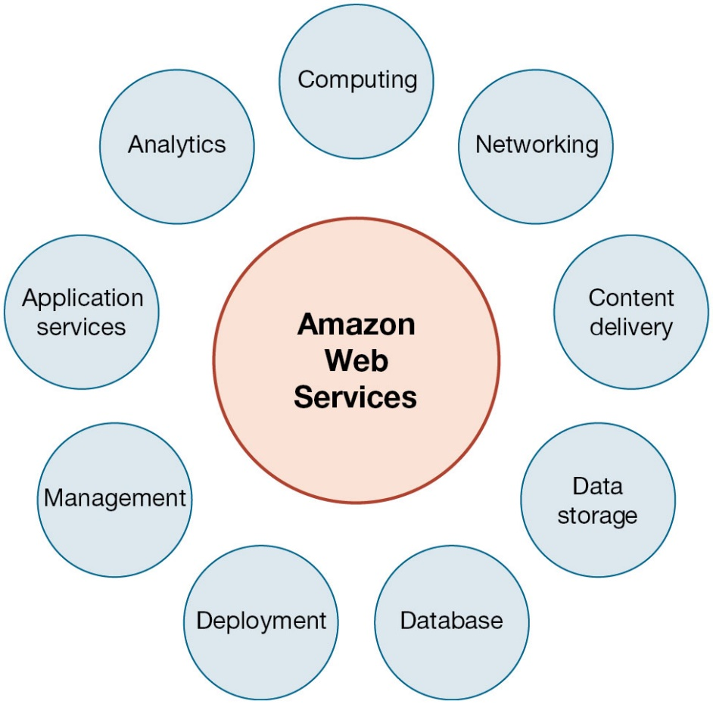
Figure 5.10 Amazon Web Services
Notes:
Figure 5.10, Page 185.
Amazon Web Services (AWS) is a collection of web services that Amazon provides to users of its cloud platform. AWS is the largest provider of cloud computing services In the United States.
Alt Text
Long description: A circular diagram lists the various web services that Amazon provides to the users of its cloud platform. Details of the services are as follows:
Computing
Networking
Content delivery
Data storage
Database
Deployment
Management
Application services
Analytics.

Slide 32
Interactive Session: Organizations: Glory Finds Solutions in the Cloud
Class discussion
  Why did Glory choose a cloud solution as opposed to modernizing the systems it had?
  Why was it necessary to hire a systems integrator firm?
  What were the main organizational change requirements for implementing the new cloud platform?
  Why did management choose a regional rollout strategy? Why in the UK?

Slide 33
What Are the Current Trends in Computer Hardware Platforms? (4 of 5)
Edge computing
  Servers at the edge of the network, near the source of the data
  Reduces latency and network traffic
Notes:
Edge computing is needed to provide efficient service to consumers located across the country. It works by reducing the distance between local computers and web resources and sharing the total load across many regional computing facilities.

Slide 34
What Are the Current Trends in Computer Hardware Platforms? (5 of 5)
Green computing (Green I T )
  Practices and technologies for manufacturing, using, disposing of computing and networking hardware
  Reducing power consumption a high priority
  Green data centers
High-performance, power-saving processors
  Multicore processors
  Power-efficient microprocessors
Notes:
Data centers consume approximately 1.5% of all energy use in the world. Cutting power consumption in data centers has become both a serious business and environmental challenge. Ask students what forms of green computing they have noticed. Answers may range from more publicized local management of electronic equipment disposal and recycling to the use of solar chargers, and so on. Another driver in minimizing the power consumption of computer processors is the proliferation of handheld devices; to reduce heat in the devices as well as lengthen time between battery charges.

Slide 35
What Are the Current Computer Software Platforms and Trends? (1 of 3)
Linux and open-source software
  Produced by community of programmers
  Examples: Apache web server, Mozilla Firefox browser, OpenOffice
  Linux
Software for the web: Java, H T M L, and H T M L 5
  Java Virtual Machine
  Web browsers
  H T M L and H T M L 5
  Ruby and Python
Notes:
Linux plays a major role in the administration of local area networks. Ask students to give reasons why an open-source operating system might be a better choice for network administrators than alternatives that are not open-source (such as Microsoft’s Windows server).
Java is designed to run on any computing device by use of the Java Virtual Machine. This includes mobile devices such as smartphones. HTML is a markup/formatting tool that creates web pages that all browsers can interpret and display regardless of the type or manufacture of the computer being used. HTML5 is the latest evolution of HTML. Ruby and Python are popular programming tools for web applications.

Slide 36
What Are the Current Computer Software Platforms and Trends? (2 of 3)
Web services and service-oriented architecture
  Web services
  X M L : Extensible Markup Language
  S O A : service-oriented architecture
    Set of self-contained services that communicate with one another to create a working software application
    Software developers reuse these services in other combinations to assemble other applications as needed
Notes:
Firms are collections of thousands of computer programs and systems built over many years. In general, these systems cannot “talk” with one another, and sharing information among them is very expensive. One way to get to work together is to build software links among them. This is the web services approach. You can compare it to the web: any computer with a browser can access billions of web pages and draw down the information or download PDF files that work on all computers that have a version of Adobe Acrobat installed. In a business firm, you want a similar environment: any computer program can get data from any other computer program. Web services makes this possible.
Ensure that students are able to explain the difference between XML and HTML (in other words, the additional features XML has compared to HTML). These include classifying, presenting, communicating, and storing data, as opposed to HTML being able to merely present data. These features also allow computers to manipulate documents written in XML automatically.
Emphasize that SOA is a method of developing infrastructure using web services with an eye toward creating applications that draw data from several underlying (usually older “legacy” programs). All programs are built or redesigned to provide certain information (services) to all other programs. With SOA, developers incorporate each individual service into an application that successfully meets the needs of the organization.

Slide 37
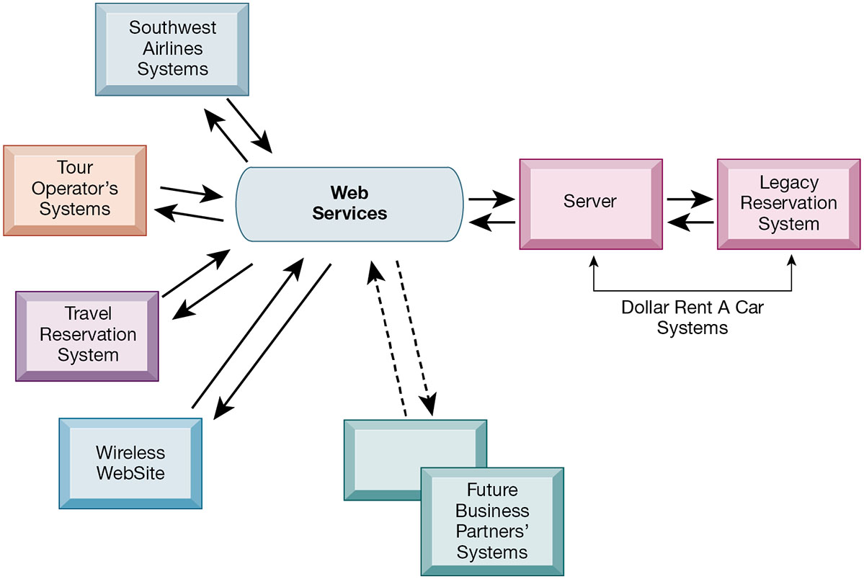
Figure 5.11 How Dollar Rent A Car Uses Web Services
Notes:
Figure 5.11, Page 193.
Dollar Rent A Car uses web services to provide a standard intermediate layer of software to “talk” to other companies’ information systems. Dollar Rent A Car can use this set of web services to link to other companies’ information systems without having to build a separate link to each firm’s systems.
Emphasize that the task Dollar wants to complete (interacting with other companies’ information systems) is represented here as a collection of individual services, in keeping with the SOA model. Dollar wants to be able to quickly and easily share data with other companies—the series of services provided above are combined to accomplish that task.
Alt Text
Long description: A sequential flow diagram explains how “Dollar Rent A Car” uses a set of web services to link to other companies’ information systems without creating separate links. The details of the diagram are as follows:
An interconnection between the web services, servers, and legacy reservation systems is shown to explain the systems of “Dollar Rent A Car”.
The web services are separately interconnected to the systems of: Southwest airlines, tour operator, travel reservation system, wireless website and future business partners.
All the interconnections are indicated by two opposite up and down solid arrows except the connection between the web services and future business partners’ systems. The same is indicated by two opposite up and down dashed arrows.

Slide 38
What Are the Current Computer Software Platforms and Trends? (3 of 3)
Software outsourcing and cloud services
  Software packages and enterprise software
  Software outsourcing
  Cloud-based software services and tools
    Service Level Agreements (S L A s): formal agreement with service providers
Mashups and apps
Notes:
This slide discusses the trends in software outsourcing and in cloud software services. Remind students that internal sources for software refers to developing software fully in house. Most companies today purchase or lease software or outsource development. Why do students think that software outsourcing is growing quickly in popularity? How about offshore outsourcing (mostly to India and other English-speaking, developing countries)? Ask students what types of software they have used online. Note that service level agreements are formal contracts between customers and their service providers that define the specific responsibilities of the service provider and the service expected by the customer. These are important to establish communication between the two firms and to manage the project efficiently.
In addition to the large enterprise software packages and services, some business tasks can be enabled through smaller programs or components that are combined to create a new function. The open-source movement, and the universal standards of Internet technologies, have created an environment in which software components can be created, used, and shared easily. Ask students which mashups and apps they have used. Have any students created any mashups or apps?

Slide 39
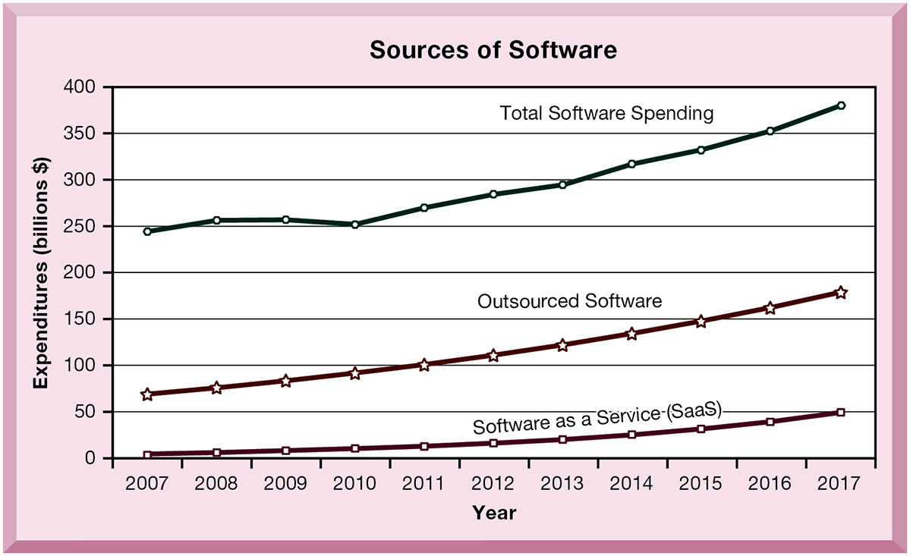
Figure 5.12 Changing Sources of Firm Software
Notes:
Figure 5.12, Page 194
Spending for software that originated outside the firm, provided by a variety of vendors, has been growing steadily.
Note the recent jump in SaaS spending within the last several years. What are the positives and negatives of acquiring software through the SaaS model? Positives: allows companies to focus on business issues rather than technology; for many companies, SaaS could cut costs. Negatives: SaaS increases the firm’s dependency on external suppliers. What happens if your supplier of SaaS services goes into bankruptcy? What is your backup plan?
Alt Text
Long description: A line graph explains how the spending on software has increased over the years. The horizontal axis represents years and ranges from 2007 to 2017, in increments of 1. The vertical axis represents the expenditure in billion dollars and ranges from 0 to 400, in increments of 50.
There are three curves in the graph belonging to: Software as a service (SaaS); Outsourced software; Total software spending.
Approximate data corresponding to the year and Software as a service curve are summarized below:
2007: 4.7; 2008: 6.0; 2009: 7.4; 2010: 12.2; 2011: 10.1; 2012: 19.4; 2013: 20.8; 2014: 27.8; 2015: 33.8; 2016: 39.7; 2017: 53.6.
Approximate data corresponding to the year and outsourced software curve are summarized below:
2007: 66.4; 2008: 74.6; 2009: 82.8; 2010: 92.2; 2011: 98.1; 2012: 109.7; 2013: 123.6; 2014: 135.3; 2015: 151.5; 2016: 162.0; 2017: 182.8.
Approximate data corresponding to the year and total software spending curve are summarized below:
2007: 243.5; 2008: 256.3; 2009: 257.7; 2010: 252.2; 2011: 268.4; 2012: 286.9; 2013: 297.4; 2014: 321.6; 2015: 329.8; 2016: 356.3; 2017: 382.8.

Slide 40
Dealing with Platform and Infrastructure Change
As firms shrink or grow, I T needs to be flexible and scalable
Scalability
  Ability to expand to serve larger number of users
For mobile computing and cloud computing
  New policies and procedures for managing these new platforms
  Contractual agreements with firms running clouds and distributing software required
Notes:
How can IT be flexible and still make long-term investments in hardware and software? SaaS may solve some problems, but ask students to envision some of the pitfalls of working with an external hardware or software vendor such as Google or Salesforce.com. What are some nightmare scenarios that companies must guard against? For instance, the vendor fails to make critical applications available when needed, poor customer service, and so on, or the vendor fails to upgrade equipment in order to save investment monies.

Slide 41
Management and Governance
Governance
Who controls I T infrastructure?
How should I T department be organized?
  Centralized
    Central I T department makes decisions
  Decentralized
    Business unit I T departments make own decisions
How are costs allocated between divisions, departments?
Notes:
What are the ramifications of poor IT governance at a firm? For example, if a company does not clearly define what departments have the responsibility to make their own IT decisions, what could be the consequences? Some potential consequences are data mismanagement, poor communication, and slower response times to crises.

Slide 42
Making Wise Infrastructure Investments
Under-investment and over-investment can hamper firm performance
Rent-versus-buy
Cloud computing
  Security requirements
  Impact on business processes and workflow
Outsourcing
Notes:
What types of companies should opt to rent as opposed to buy software? Possibly, companies with seasonal employees or semi-annual workloads. What differences between the two can students point to?

Slide 43
Total Cost of Ownership (T C O) Model
Analyzes direct and indirect costs
Hardware, software account for only about 20% of T C O
Other costs: Installation, training, support, maintenance, infrastructure, downtime, space, and energy
T C O can be reduced
  Use of cloud services, greater centralization and standardization of hardware and software resources
Notes:
TCO is a way of quantifying some of the hidden costs of hardware and software. Ask students to make the connection between the TCO of handling software and hardware infrastructure internally as opposed to acquiring it from an outside vendor. Is this an additional incentive to outsource?

Slide 44
Competitive Forces Model for I T Infrastructure Investment
Market demand for firm’s services
Firm’s business strategy
Firm’s I T strategy, infrastructure, and cost
Information technology assessment
Competitor firm services
Competitor firm I T infrastructure investments
Notes:
How great of an impact do competitors’ services and investments have on a firm’s IT services and infrastructure? Is it wise to rely on those factors alone to determine what kind of services your firm provides? For instance, your competitors may not be the industry’s best example of how to develop IT services. In fact, your entire industry might be technological laggards. In this case, it might be better to look at best practices in other industries which have a reputation for superior IT services and capabilities.

Slide 45
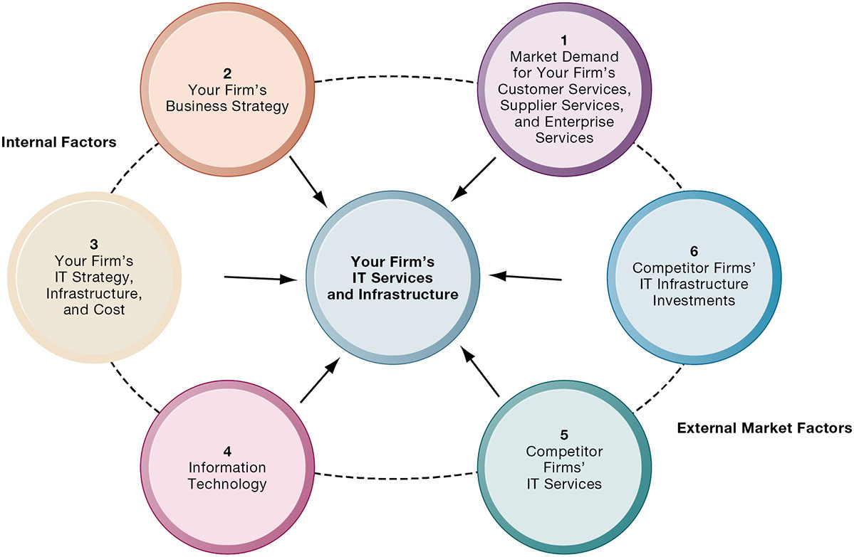
Figure 5.13 Competitive Forces Model for I T Infrastructure
Notes:
Figure 5.13, Page 199.
There are six factors you can use to answer the question “How much should our firm spend on IT infrastructure?”
Ask students to explain how each item affects a firm’s IT services and infrastructure. Do they feel that any one of the six is especially important (or unimportant)? You can also use this diagram as a framework for understanding why some firms fail to develop a workable, powerful IT infrastructure.
Alt Text
Long description: A converging radial diagram illustrates the forces acting upon a firm’s IT services and infrastructure. To the left of the radial diagram are the internal forces such as:
Your firm’s business strategy
Your firm’s IT strategy, infrastructure, and cost
Information technology.
These forces are numbered: 2, 3, and 4 respectively.
To the right of the radial diagram are the external market forces such as:
Market demand for your firm’s customer services, supplier services, and enterprise services
Competitor firms’ IT infrastructure investments
Competitor firms’ IT services.

Slide 46
How Will M I S Help My Career?
The Company: A1 Tech I T Consulting
Position Description: Entry-level I T consultant
Job Requirements
Interview Questions
Author Tips
Notes:
A good opportunity for a class discussion on how MIS will help students with their current or future careers. Would any in the class be interested in a job like this? What do they think are the most important skills the employer is looking for? How would they answer the interviewer questions?

Slide 47

Copyright
This work is protected by United States copyright laws and is provided solely for the use of instructors in teaching their courses and assessing student learning. Dissemination or sale of any part of this work (including on the World Wide Web) will destroy the integrity of the work and is not permitted. The work and materials from it should never be made available to students except by instructors using the accompanying text in their classes. All recipients of this work are expected to abide by these restrictions and to honor the intended pedagogical purposes and the needs of other instructors who rely on these materials.

